Slide 1

DATA ANALYTICS PROJECT
Budget vs Actual
Expense Analysis
From raw Kaggle data to an interactive Power BI dashboard — sourcing, cleaning in Google Colab, modeling in Power Query, and visual storytelling.
Kaggle Dataset • Google Colab (Python) • Power Query • Power BI
PRESENTED BY
Pavan Kumar • Sonu Pal

Slide 2




HOW THIS PROJECT WAS BUILT
Project Workflow at a Glance
01
02
03
04
Source the Data
›
Clean in Colab
›
Model in Power Query
›
Build the Dashboard
Downloaded the Budget vs Actual expense dataset from Kaggle (10,010 transactions, 8 fields).
Used Python (pandas) in Google Colab to inspect, de-duplicate, and handle missing values.
Loaded the cleaned file into Power BI and assigned correct data types via Power Query.
Designed KPI cards, charts, and slicers to turn the data into decision-ready visuals.
Budget vs Actual Expense Analysis
2

Slide 3


STEP 1 · DATA SOURCING
About the Dataset
10,010
Kaggle — Budget vs Actual Data
raw transaction rows
A transaction-level financial dataset (Excel file) covering three years of departmental spending, uploaded to Google Colab for cleaning.
8
Date Transaction date (2021 – 2023)
data columns
Department HR, Sales, Finance, Operations, Marketing, IT
Category Travel, Utilities, Training, Marketing, Infrastructure, Salaries
3
Region Central, East, North, South, West
years covered (2021–2023)
Budget Amount / Actual Amount Planned vs. spent value per transaction
6 · 6 · 5 · 4
Payment Method Card, UPI, Bank Transfer, Cash
departments · categories · regions · payment types
Transaction ID Unique record identifier
Budget vs Actual Expense Analysis
3

Slide 4

STEP 2 · DATA WRANGLING
Cleaning the Data in Google Colab
1
Load & Inspect
Read the Kaggle Excel file into pandas; reviewed .head(), .info() and .describe() to understand structure and types.
ROWS BEFORE → AFTER
10,010 → 10,002
2
Check for Nulls
df.isnull().sum() found a small number of missing values: 1 Department, 1 Category, 3 Region, 3 Transaction ID.
8 incomplete rows removed (nulls + duplicates) — a data-quality loss of just 0.08%.
3
Remove Duplicates
Ran df.drop_duplicates() to ensure every transaction row is unique.
Tools Used
4
Drop Missing Rows
Python · pandas · NumPy
Google Colab notebook (Cleaning.ipynb)
Used df.dropna() to remove the incomplete rows, leaving a fully populated dataset.
Export Cleaned File
Output: cleaned_budget_vs_actual_data.xlsx — ready to load into Power BI.
5
Saved the result as cleaned_budget_vs_actual_data.xlsx and downloaded it for Power BI.
Budget vs Actual Expense Analysis
4

Slide 5



STEP 3 · DATA MODELING
Preparing the Data in Power BI (Power Query)
Import
Assign Data Types
Loaded cleaned_budget_vs_actual_data.xlsx into Power BI Desktop via Get Data.
Set Date to Date/Time, Budget Amount & Actual Amount to whole numbers, and text fields to Text in Power Query Editor.
Create Measures
Load to Model
Built DAX measures for Total Variance (Actual − Budget) and Variance % ((Actual − Budget) / Budget).
Applied the query and loaded the shaped table into the report's data model, ready for visuals.
Budget vs Actual Expense Analysis
5

Slide 6



STEP 4 · DESIGN PLAN
Dashboard Design: KPIs, Charts & Slicers
Total Budget
Total Actual Expense
Total Variance
Variance %
Budget vs Actual by Department
Budget vs Actual by Category
Budget vs Actual Trend
Clustered column — surfaces which departments exceed budget.
Clustered bar — flags spending categories with the biggest gaps.
Line chart — tracks planned vs. spent value by region over time.
Budget vs Actual by Region
Actual Expense by Payment Method
Overspending by Department
Clustered column — highlights regions with higher overspend.
Donut chart — shows the spend split across payment channels.
Bar chart, sorted descending by variance — ranks the biggest risks.
Slicers added for Region and Department so every visual can be filtered interactively.
Budget vs Actual Expense Analysis
6

Slide 7


RESULTS · KPI OVERVIEW
The Headline Numbers
796M
890M
95M
+11.9%
Total Budget
Total Actual Expense
Total Variance
Variance %
Actual spending outpaced budget across every department, region and category — total overspend reached 95M, about 12% above plan.
Budget vs Actual Expense Analysis
7

Slide 8
RESULTS · CHART INSIGHTS
Where Is the Overspend Coming From?
Budget vs Actual by Department
Budget vs Actual by Category
Budget vs Actual Expense Analysis
8

Slide 9
RESULTS · CHART INSIGHTS
Regional Spread & Payment Channels
Budget vs Actual by Region
Actual Expense by Payment Method
Budget vs Actual Expense Analysis
9

Slide 10

RESULTS · CHART INSIGHTS
Overspending by Department — Ranked
Reading the Chart
Marketing and HR carry the largest absolute overspend, each roughly 18–20M above budget.
Finance is the most disciplined department, with the smallest variance of the six.
Sorting by variance (descending) turns a routine bar chart into a prioritized action list for finance teams.
Budget vs Actual Expense Analysis
10

Slide 11
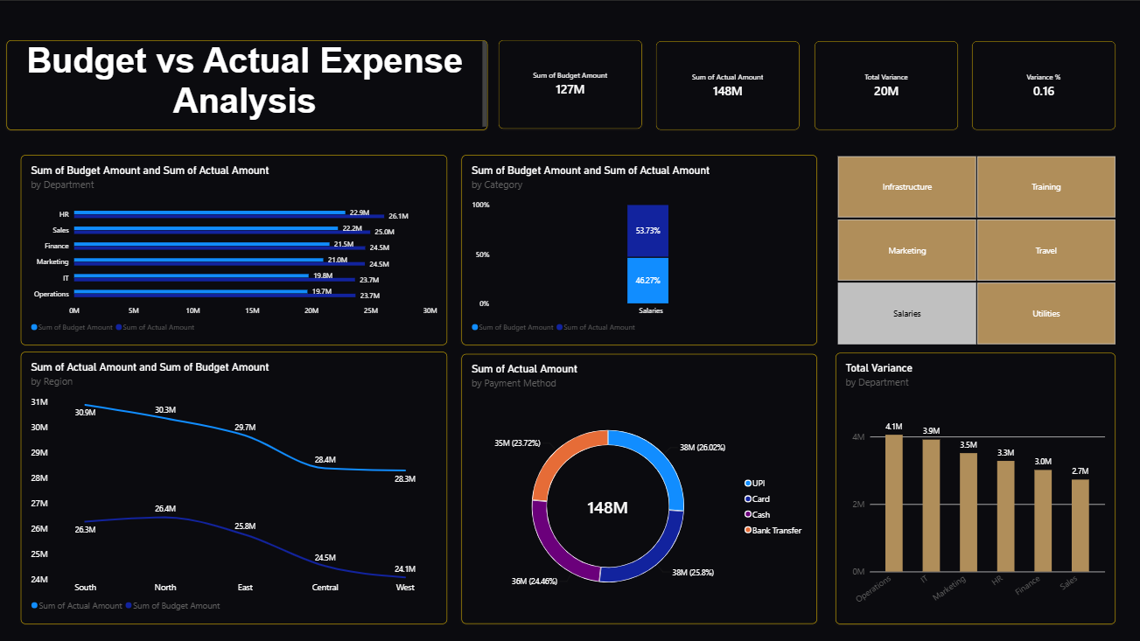
STEP 5 · FINAL OUTPUT
The Live Power BI Dashboard
Budget vs Actual Expense Analysis
11

Slide 12
TAKEAWAYS
Key Insights & Recommendations
Overspend is broad-based
Marketing & HR lead the gap
Every department, region, category and payment method spent above budget — this is a systemic pattern, not one outlier.
Together they account for roughly 38M of the 95M total variance and should be reviewed first.
Payment mix is balanced
Travel & Utilities run hottest
UPI, Card, Bank Transfer and Cash are each within ~1pt of a 25% share — no channel-specific risk.
These two categories show the largest budget-to-actual gaps among all six categories.
RECOMMENDED NEXT STEPS
→ Tighten budget-setting for Marketing and HR using 2021–2023 actuals as a baseline, not last year's budget alone.
→ Add monthly variance alerts in Power BI so overspend is caught mid-quarter, not at year-end.
→ Investigate Travel and Utilities contracts/vendors for renegotiation opportunities.
Budget vs Actual Expense Analysis
12

Slide 13

From Raw Data to Insight
Thank You
Kaggle dataset → Google Colab cleaning → Power Query modeling → Power BI dashboard.
Questions and feedback are welcome.

